Slide 1
The Design of an Efficient Swap Mechanism for
Hybrid DRAM-NVM Systems
Xianzhang Chen, Edwin H.-M. Sha, Weiwen Jiang, Qingfeng Zhuge, Junxi Chen, Jiejie Qin, and Yuansong Zeng
EMSOFT 2016

Slide 2
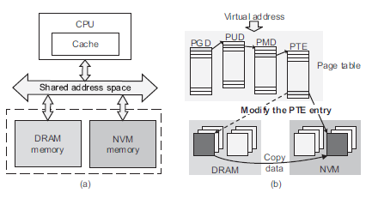
Motivation
A system with a NVM-based swap area is expected to achieve high performance and low energy consumption.
directly linked to the memory bus (a)
sharing the address space with DRAM (b)
NVM Problem
larger write latency and write energy
limited number of programming cycles
The data access features of the applications, especially the write operations, should be considered in designing the swap mechanisms for the systems with NVM-based swap area.
EMSOFT 2016

Slide 3
Swapping Mechanisms
Linux systems
generally block devices
cannot be directly accessed via virtual addresses
→ If the system needs to access the data on swap zones, the system should first swap the corresponding page into the main memory.
Hybrid memory systems
NVM
sharing virtual address space of DRAM and NVM
→ directly read any times without swap-in (Direct Read Swap)
EMSOFT 2016

Slide 4
Refinery Swap
Design Motive
the high overhead of swap operations
write count disparity
→ The counts of pages are unequally distributed among all the pages.
Reduce the number of swap operations and the number of NVM writes by extracting the data access features of the applications
NVM Page Screening
Write-aware Swap-out
EMSOFT 2016

Slide 5
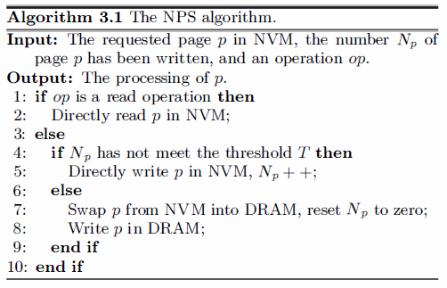
Refinery Swap
NVM Page Screening
Tolerating small writes to NVM for reducing the number of swap operations
EMSOFT 2016

Slide 6
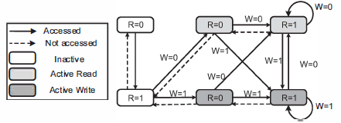
Refinery Swap
Write-aware Swap-out
Write Aware Least Recently Used (WA-LRU)
→ define three LRU queues for the pages in DRAM
WA-LRU algorithm
EMSOFT 2016

Slide 7
Experimental Setup
Using simulator which characterizes the DRAM and NVM hybrid memory architecture for different kinds of swap mechanisms
Swap mechanisms
Linux Swap (baseline)
DR.Swap
M-CLOCK
DRAM 1GB
NVM 512MB
Page 4KB
MiBench (twelve benchmarks)
EMSOFT 2016

Slide 8
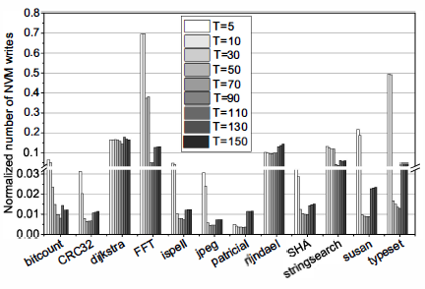
Experimental Setup
Threshold Setting of NPS
Set the general configuration of T as 90
The number of NVM writes related to different configurations of the threshold in NPS.
EMSOFT 2016

Slide 9
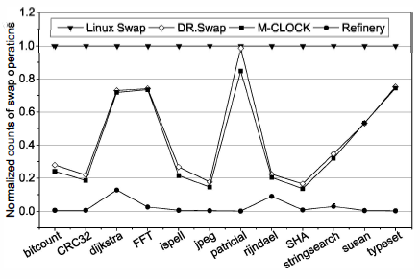
Evaluation
The number of swap operations
Refinery Swap reduces the number of swap operations by 97.4%, 92.9%, and 92.3% on average for Linux Swap, DR.Swap, and M-CLOCK, respectively.
Comparing the number of swap operations obtained from each swap mechanism.
EMSOFT 2016

Slide 10
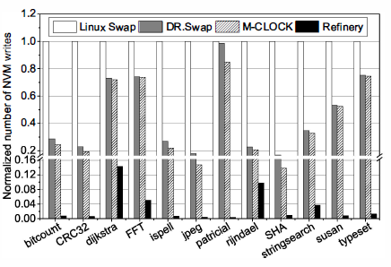
Evaluation
The number of NVM writes
Refinery Swap reduces the number of NVM writes by 96.7%, 91.6%, and 90.8% on average for Linux Swap, DR.Swap, and M-CLOCK, respectively.
Comparing the number of NVM writes obtained from each swap mechanism.
EMSOFT 2016

Slide 11
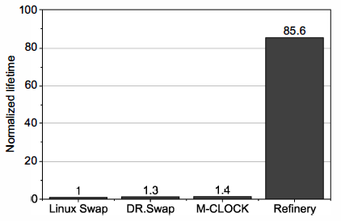
Evaluation
Effect on Lifetime
The lifetime of NVM for the system with Refinery Swap is 85.6 times, 69.5times, and 60.8 times that of Linux Swap, DR.Swap, and M-CLOCK, respectively.
Comparison of the lifetime of NVM.
EMSOFT 2016

Slide 12
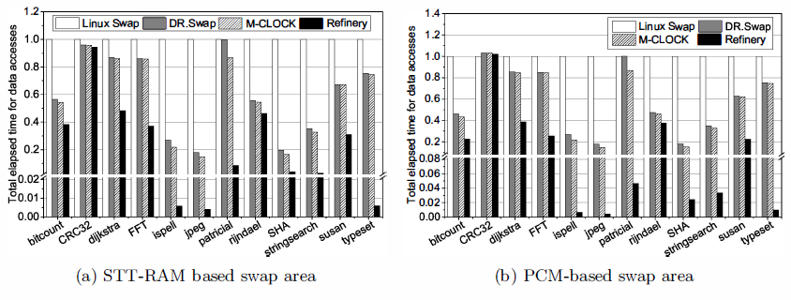
Evaluation
Effect on System Performance
Measuring the time for completing all the data access of the workloads.
The average performance of Refinery Swap achieves 48 times, 17 times, and 15 times higher than Linux Swap, DR.Swap, and M-CLOCK, respectively.
The total elapsed time with different NVM-based swap areas.
EMSOFT 2016

Slide 13
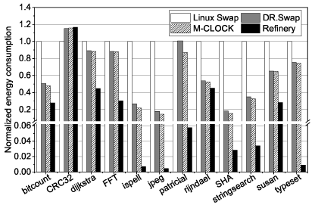
Evaluation
Effect on Energy Consumption
The average energy consumption of the proposed Refinery Swap is 47.9 times, 17.3 times, and 15.6 times lower than that of Linux Swap, DR.Swap, and M-CLOCK, respectively.
Comparison of energy consumption.
EMSOFT 2016

Slide 14
Conclusion
Replace part of the DRAM with NVM, and use it as a swap area.
Most of swap mechanisms proposed for the hybrid DRAM-NVM systems have limited performance without considering the data access features of applications.
Refinery Swap presented two algorithms to exploit the data access feature of applications.
→ the NPS algorithm
→ WA-LRU algorithm
Refinery Swap reduces the number of swap operations and the number of writes on NVM.
→ extends the lifetime of NVM, improves the performance, reduces the energy consumption
EMSOFT 2016

Slide 15
Thank you!
EMSOFT 2016

